Slide 1
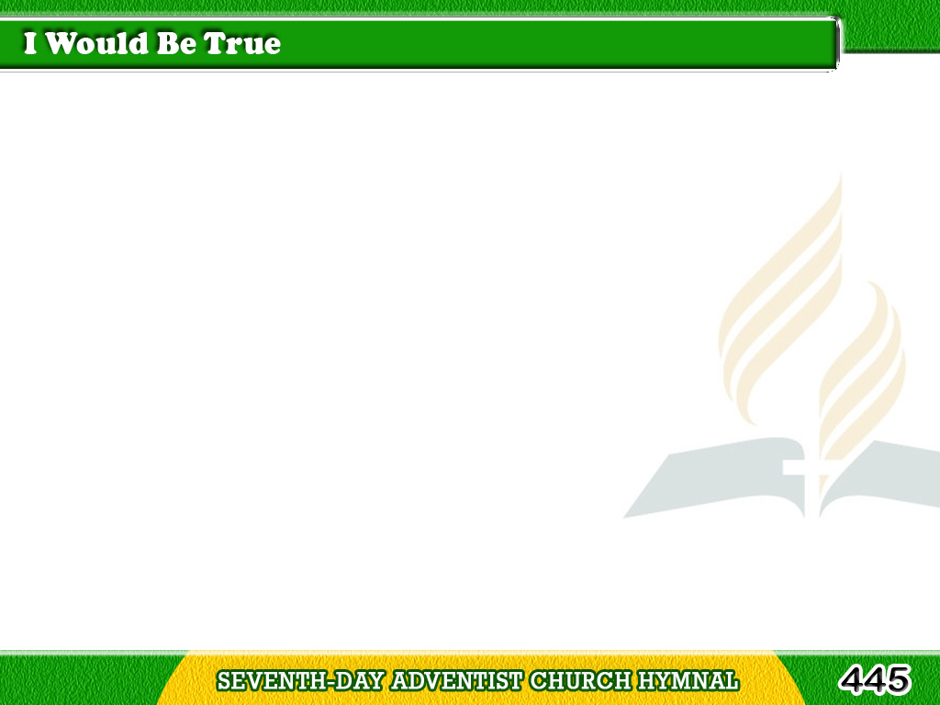
1/3
I would be true,
for there are those
who trust me;
I would be pure,
Tagalog
Version

Slide 2
1/3
for there are those who care;
I would be strong,
for there is much to suffer;
Tagalog
Version

Slide 3
1/3
I would be brave,
for there is much to dare;
I would be brave,
for there is much to dare.
Tagalog
Version

Slide 4
2/3
I would be friend
of all the foe,
the friendless;
Tagalog
Version

Slide 5
2/3
I would be giving,
and forget the gift;
I would be humble,
for I know my weakness;
Tagalog
Version

Slide 6
2/3
I would look up and laugh
and love and lift;
I would look up and laugh
and love and lift.
Tagalog
Version

Slide 7
3/3
I would be learning,
day by day, the lessons
My heavenly Father
Tagalog
Version

Slide 8
3/3
gives me in His word;
I would be quick
to hear His lightest whisper,
Tagalog
Version

Slide 9
3/3
And prompt and glad
to do the things I’ve heard;
And prompt and glad
to do the things I’ve heard.
Tagalog
Version

